Slide 1
Intro to Design Patterns
Lecture 1.2 – Adapter Pattern

Slide 2
Notes About Code & Presentation
Code Style
Compressed to fit in vertical space
Namespaces
Use to support code folding and group evolution of code
Comparisons
Code presented side-by-side as much as possible
Text and Other Explanations
Typically on slide before code to maximize space for the code itself
Expect 3 namespaces, <dp>_legacy, <dp>_problem, <dp>_solution
Read the comments

Slide 3
Reading
DPE
Chapter 7 – The Adapter Pattern

Slide 4
If the Interfaces are varying use the Adapter pattern
Technique
Base class with pure virtual functions.
Private instance of the “adaptee” class in the Adapter class.
Derived class methods simply call the methods of the “adaptee” class.
Benefits
Client code uses classes polymorphically.
Follows open/closed principle.
Alternatives suffer from coupling, code duplication, obscurity, multiple & growing seam points, violate open/closed principle, and require error handling.

Slide 5
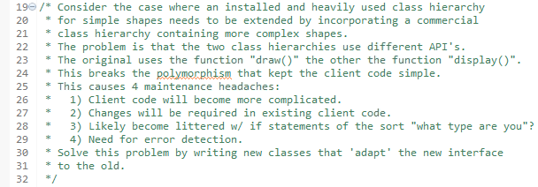
Homework

Slide 6
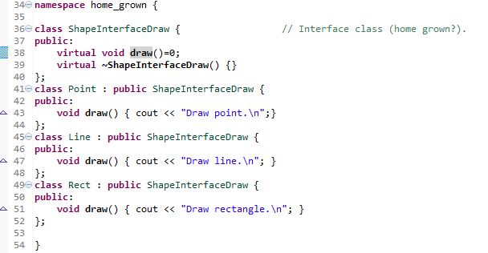
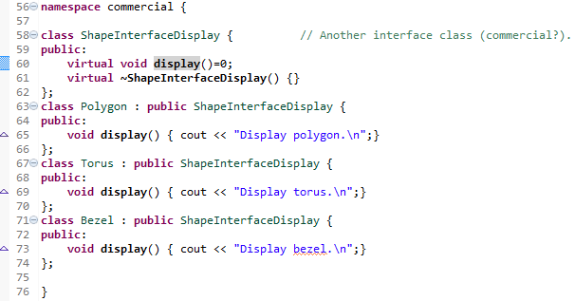
Home Grown versus Commercial Interfaces

Slide 7
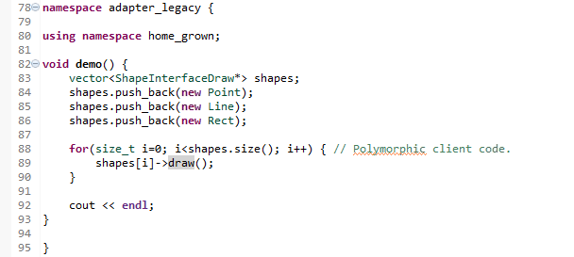
Clean Legacy Code

Slide 8
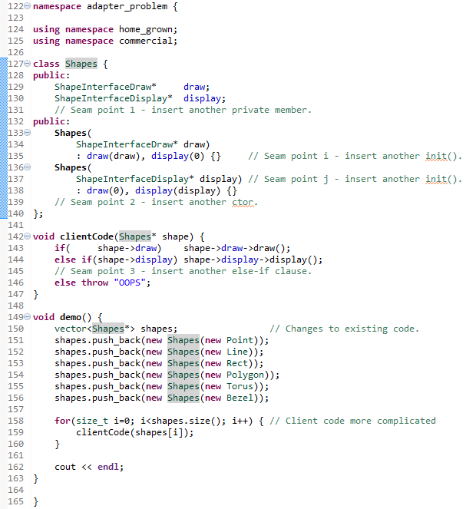
Kludgy Problem Code
Violates open/closed principle.
Multiple seam points.
Number of seam points increases over time with each new interface to be adapted.

Slide 9
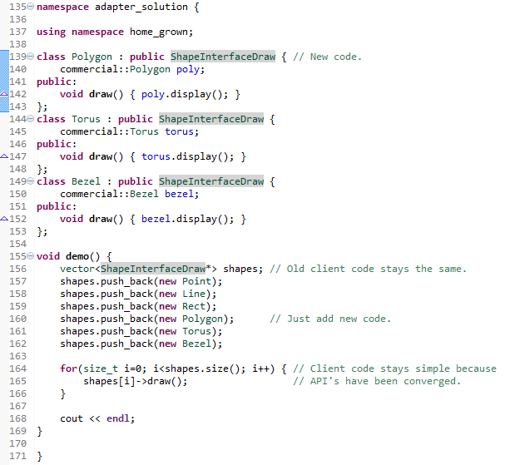
Clean Code Using Adapter Pattern

Slide 10
Summary
When the interfaces are varying, use the Adapter pattern to encapsulate the variations.
An instance of the class to be adapted is a private member of the Adapter class.
Each adapted class inherits from the conforming class.
Virtual function simply calls the correct adapted function.
Client code remains polymorphic, follows the open/closed principle.

Slide 11
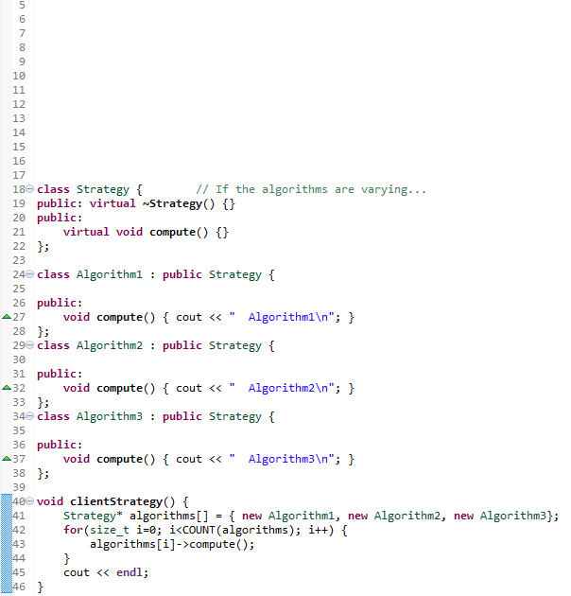
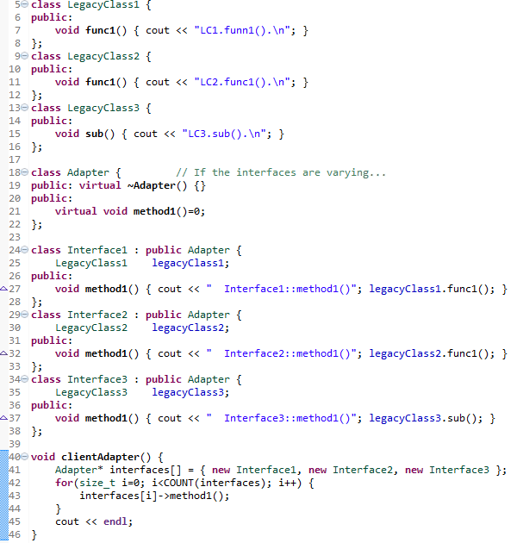

Slide 12
Class Progress
If the algorithms are varying
If the interfaces are varying
If the API’s are varying
If the steps are varying
If the classes are varying
If the options are varying
If the listeners are varying
If the responders are varying
If abstract’n & implement’n vary
If the families are varying
Use the Strategy pattern
Use the Adapter pattern
Use the Facade pattern
Use the Template Method pattern
Use the Factory Method pattern
Use the Decorator pattern
Use the Observer pattern
Use Chain of Responsibility pattern
Use the Bridge pattern
Use the Abstract Factory pattern

Slide 13
